Slide 1
A Major Project on Tocklai Publications Management System Prepared By:- Arpanjyoti Parasar Roll No-40120007 Sudeep Bhardwaj Roll No-40120033 Guide-Gautam Kr Adhyapak

Slide 2
Tocklai Publication Management System
Introduction : Our Tocklai Publications Management is a web based software which mainly keeps the records of the different publications by TRA.(Tea Research Association) User can sell, transfer the required items to their customers and generate a invoice receipt. Administrator can add the publications to the database, manage the records of stock and the selling reports too. This system structure is become very simple to understand because of data flow diagram provided by us .

Slide 3
Objectives of the Tocklai Publication Management System
1) The main objective of the project is to develop software that facilitates the data storage , data maintenance and its retrieval for the system in an igneous way .
2) To store the record of the publications , the staff that has the privileges to access , modify and delete any record and finally the service , the system provides to its customers .
3) Also , only the staff has the privilege to access any database and make the required changes , if necessary .
4) To develop easy to use software which handles the customer-staff relationship in a effective manner .
5) To develop a user friendly system that requires minimal user training . Most of features and function are similar to those on any windows platform .

Slide 4
Hardware & Software Requirement
Hardware Requirement:
Processor : Pentium IV 2GHz and Above
RAM : 1GB RAM
Monitor : 15” Color Monitor
Keyboard
Mouse
Software Requirement:
Operating System. : Windows
Developing Tool : PHP, HTML, CSS, Java script
Database : MYSQL

Slide 5
DFD

Slide 6
Tocklai Publications Mangement system
Books & other details
Order receipt & confirmation
Admin
User
Order & reports
Personal Details & Select product
Context Level DFD

Slide 7
Admin
Status
Data
1.0
Admin Process
1.0
Store
Reviews
Access
process
Publications
Product
Product
Sell
Level-1 DFD

Slide 8
User
Login
Select Product
3.0
Book info
Publications
order Details
Add to Cart
3.1
Selected Product
Cart
User
confirms
Checkout
3.2
3.2
Cart Details
Confirmation & receipt
Place Order
Sell
Level-2 DFD

Slide 9
ER-Diagram

Slide 10
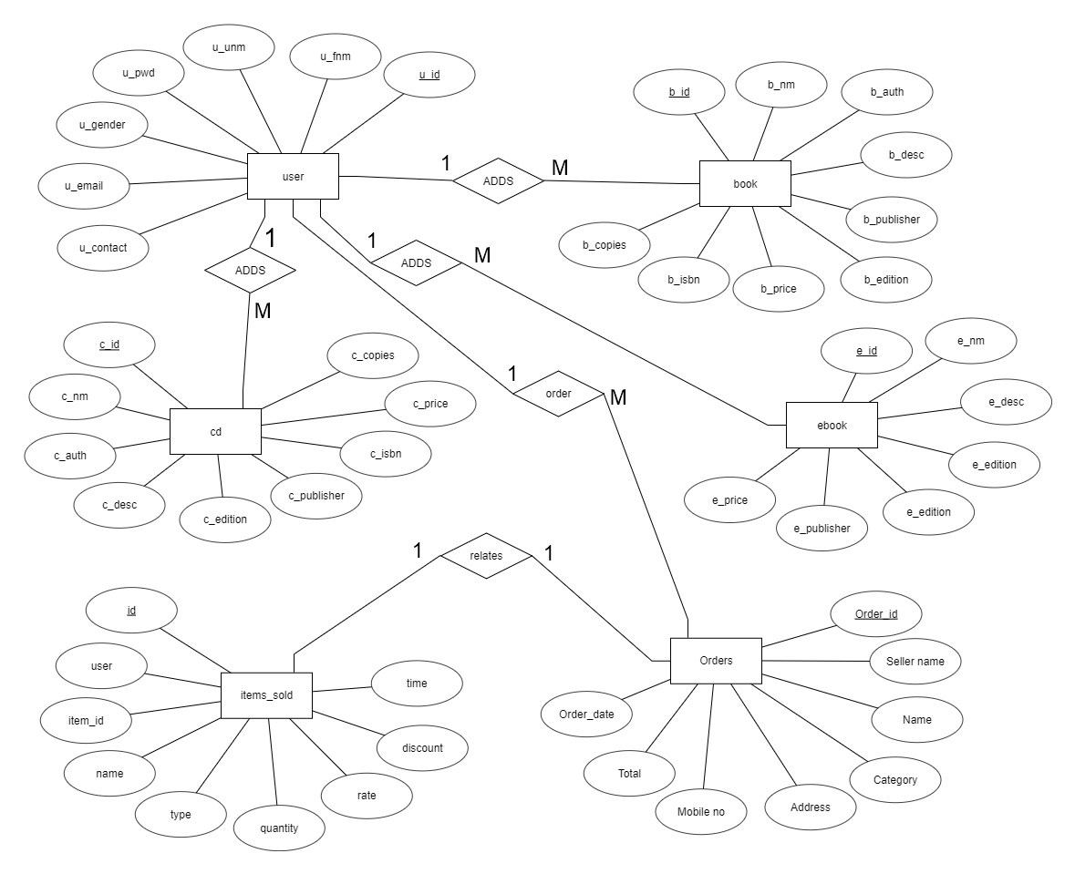
ER diagram

Slide 11
Thank You

